Slide 1

Practical 13
Preorder, Inorder, and Postorder Traversals

Slide 2

Lesson Plan
Subject/Course | Competitive Coding
Lesson Title | Preorder, Inorder, and Postorder Traversals
Lesson Objectives
A tree is a hierarchical data structure consisting of nodes.
The topmost node is called the root.
Each node may have child nodes, Nodes without children are called leaf nodes.
Traversal means visiting each node of the tree exactly once.

Slide 3
Problem Statement:
Write a Program to Understand and implement Tree traversals i.e. Pre-Order Post-Order, In-Order.

Slide 4
Concept
Tree traversal means visiting every node of a tree in a specific order (once only).
There are mainly three depth-first traversals:
Traversal Type | Order of Visit | Example (for tree below)
Preorder | Root → Left → Right | A B D E C F
Inorder | Left → Root → Right | D B E A F C
Postorder | Left → Right → Root | D E B F C A

Slide 5
Algorithm/Logic
Concept:
Traversal = visiting every node once in a specific order using recursion.
🔹 Preorder (Root → Left → Right)
Steps:
Visit Root
Traverse Left
Traverse Right Output: A B D E C F

Slide 6
Algorithm/Logic
🔹 Inorder (Left → Root → Right)
Steps:
Traverse Left
Visit Root
Traverse Right Output: D B E A F C

Slide 7
Algorithm/Logic
🔹 Postorder (Left → Right → Root)
Steps:
Traverse Left
Traverse Right
Visit Root Output: D E B F C A

Slide 8
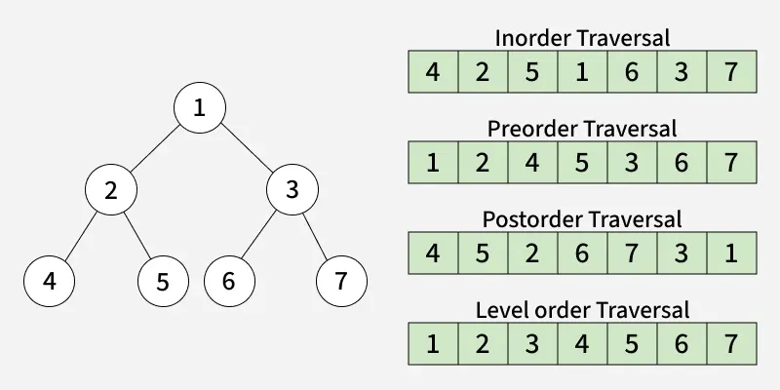
Visualization

Slide 9
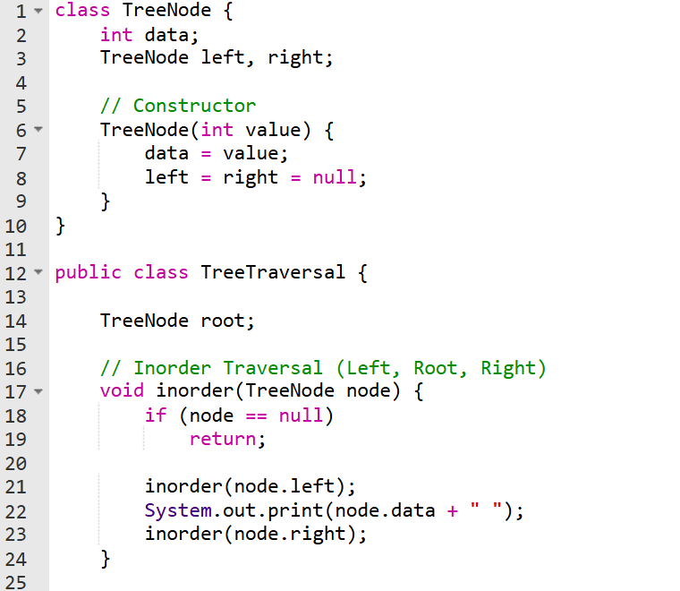
Code Implementation

Slide 10
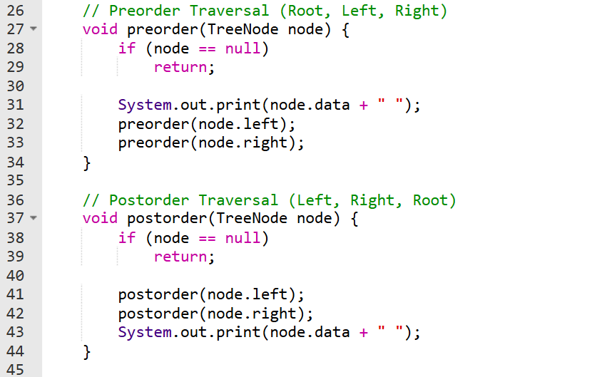

Slide 12
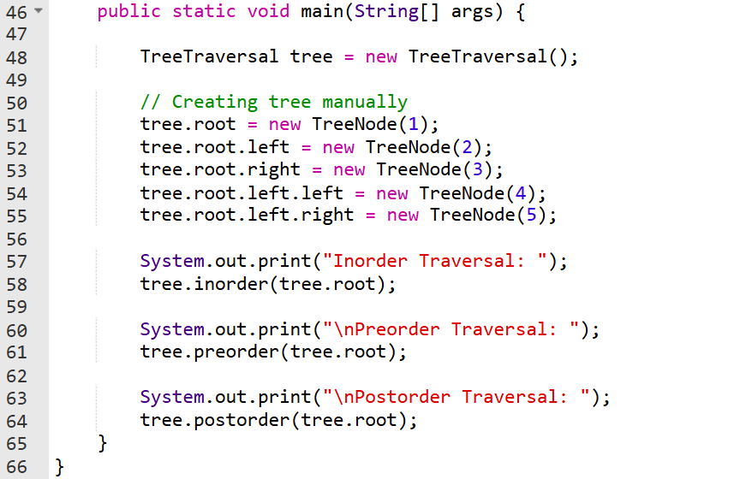

Slide 13
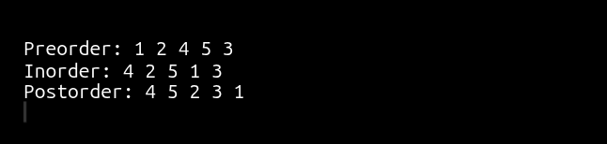
Output:

Slide 14
Time & Space Complexity
Traversal Type | Time Complexity | Space Complexity (Recursion Stack) | Explanation
Preorder | O(n) | O(h) | Each node is visited once; recursion depth = tree height (h).
Inorder | O(n) | O(h) | Visits every node exactly once; stack used for recursion.
Postorder | O(n) | O(h) | Each node processed after its children; same depth as others.

Slide 15
Summary
Tree traversal means visiting every node exactly once in a specific order.
There are three main Depth-First Traversals:
Preorder (Root → Left → Right): Used to create or copy a tree.
Inorder (Left → Root → Right): Retrieves nodes in sorted order for BSTs.
Postorder (Left → Right → Root): Used to delete or free the tree.
All traversals have Time Complexity = O(n) and Space Complexity = O(h),
where h is the height of the tree.
Traversals are the foundation of tree operations like searching, expression evaluation, and serialization.

Slide 16
Practice Questions:
Binary Tree Inorder Traversal — LeetCode #94
🔗 https://leetcode.com/problems/binary-tree-inorder-traversal/
Concept: Implement Inorder Traversal (Left → Root → Right) of a binary tree using recursion or an iterative stack-based approach.
Why Practice:
Reinforces understanding of traversal order.
Tests recursion and stack manipulation.
Foundation for solving BST and expression tree problems.

Slide 17
Practice Questions:
2. Binary Tree Preorder Traversal — LeetCode #144
🔗 https://leetcode.com/problems/binary-tree-preorder-traversal/
Concept: Perform Preorder Traversal (Root → Left → Right) of a binary tree. You can solve it recursively or iteratively using a stack.
Why Practice:
Builds clear understanding of visiting order.
Improves recursive thinking and stack-based problem solving.
Prepares for advanced problems like serialization/deserialization of trees.

Slide 18
Practice Questions:
3. Binary Tree Postorder Traversal — LeetCode #145 🔗 https://leetcode.com/problems/binary-tree-postorder-traversal/
Concept: Postorder Traversal: Left → Right → Root Can be solved recursively or iteratively using a stack.
Why Practice:
Improves understanding of tree traversal order
Strengthens recursion and stack concepts

Slide 19
Thanks

